Slide 1

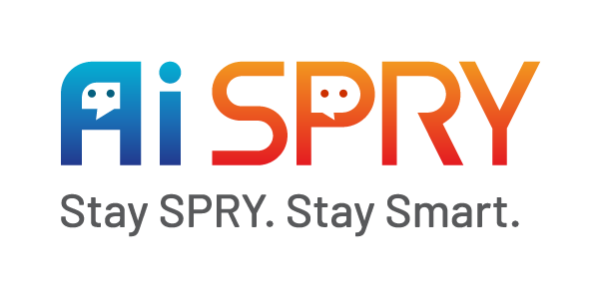
HealthCare Performance Dashaboard & ChatBot

Slide 2
About Project
Project Statement
Project Team
Project Objectives
Business Problem: Healthcare organizations struggle with siloed data, inefficient resource utilization, and limited insights into performance metrics, leading to suboptimal operational efficiency, financial management, and patient outcomes.
Business Objective: To develop an advanced healthcare analytics platform that leverages real-time data and AI-driven insights to improve clinical decision-making, enhance operational efficiency, and optimize patient experience.
Sujana Billava Kashinath Konade
The project aims to build a healthcare analytics platform that delivers real-time performance insights, AI-driven personalized recommendations, and role-specific analytics to improve clinical outcomes, operational efficiency, and resource optimization.

Slide 3
Weekly Report – 20-27 Jan/25 – Targets
Research About Chat Bot
Embed Report to Streamlit
Research about LLM VS NLP

Slide 4
Weekly Report – 20-27 Jan/25 – Work Completed
Activity | Completion Status | Comments
Understanding Business Domain | Completed | Understanding domain knowledge and gaining insights into the specific field or industry to ensure the data, models, and solutions align with real-world applications and challenges.
Hospital Visit | Completed | Conducted an on-site visit to the hospital to understand their workflow, and identify key pain points and challenges related to inventory management.
Data Collection | Completed | Created the dataset manually with the help of ChatGPT based on business requirements.
Data Understanding | Completed | Created data directory according to the datasets collected.
Power BI dashboard | Completed | Created a dashboard based on the requirements and the dataset.

Slide 5
Weekly Report - 20-27 Jan/25 – Challenges/Spillovers
Activity/Spillovers | Comments
Hospital Visit | Hospital visit to understand their workflow and identify key pain.
Challenges | Mitigation
Data Collection | Attempted to find a dataset from public websites but was unable to locate one, so we created the dataset manually based on the problem requirements.

Slide 6



Weekly Report - 20-27 Jan/25 – Activity Information
Define key areas of focus:
Operator Module Analytics: Resource management, financial tracking, operational performance, patient experience.
Physician Module Analytics: Patient outcomes, treatment efficacy, quality measures, resource optimization.
Explain how ChatGPT can be used:
Generating Python code snippets for dataset creation.
Drafting schemas for simulated or real-world healthcare datasets.
Example workflow:
Input: Prompt ChatGPT with dataset requirements.
Output: Code for creating structured data, such
Steps in Python Implementation:
Install necessary libraries like pandas, numpy, faker ect.
Use Python to create structured datasets (e.g., patient records, shift schedules).
Perform checks to ensure the dataset adheres to domain requirements (e.g., correct date formats, valid patient IDs).
Save the dataset in CSV, Excel, or a database format for further analysis.

Slide 7
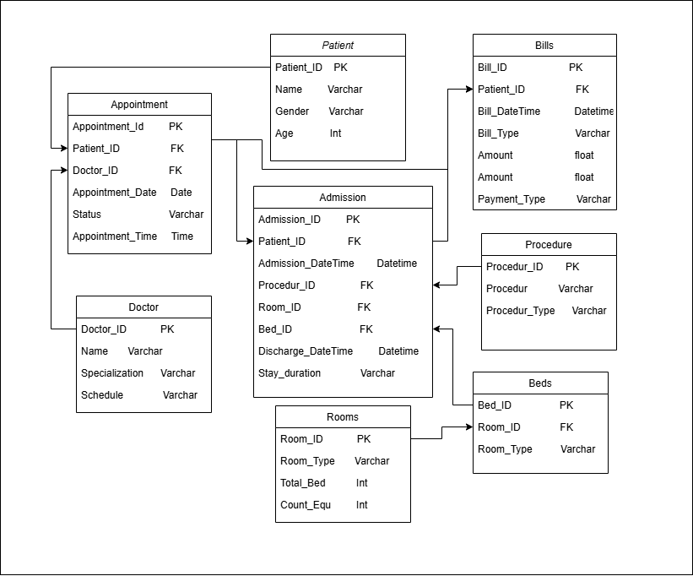
Weekly Report - 20-27 Jan/25 – Activity Information
Data Set Architecture
Based on requirement Create this Architecture using draw.io
Table Name:
Appointment
Admission
Patient
Procedure
Doctor
Rooms
Beds
Bills

Slide 8
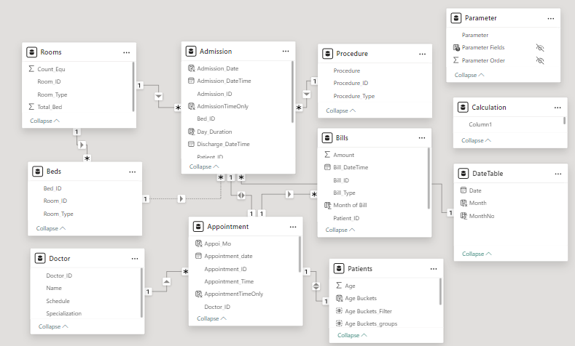
Weekly Report - 20-27 Jan/25 – Activity Information
Create Relationship between Tables

Slide 9
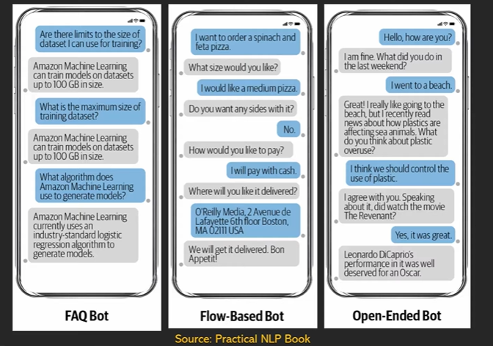
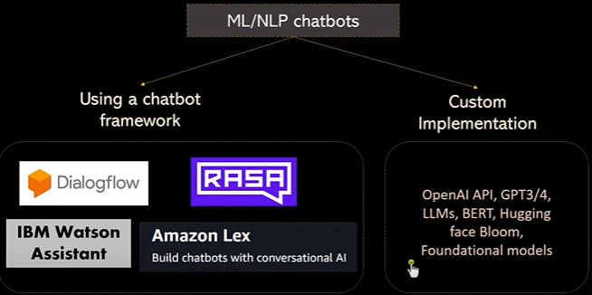
Weekly Report - 20-27 Jan/25 – Activity Information
Types of Chat Bot

Slide 10
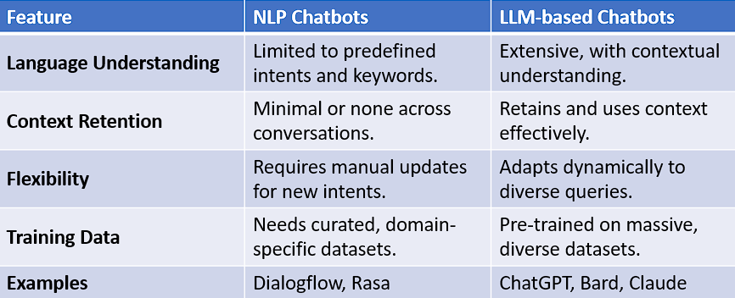
Weekly Report - 20-27 Jan/25 – Activity Information
LLM VS NLP

Slide 11
Weekly Report – 27-03 Feb/25 – Targets
Create a chatbot that allows users to ask questions in natural language and receive intelligent, context-aware responses based on the user's specific needs.
Research NLP Techniques.
Implement algorithms that allow the chatbot to generate intelligent, context-specific responses based on the user's query and role (e.g., physician or operator).

Slide 12

Thank You
https://aispry.com/
Email id: info@aispry.com
AiSPRY
Level 16, 1 Sentral, Jalan Stesen Sentral 5, KL Sentral, 50740,
Kuala Lumpur, Malaysia.
AiSPRY
2-56/2/19, Vijaya Towers,
Ayyappa Society Road,
Madhapur, Hyderabad, Telangana 500081
AiSPRY
#49, 1st Floor, 27th Main,
1st Cross, BTM 1st Stage,
Bengaluru, Karnataka 560068
AiSPRY
1st floor, Santi Ram Centre, opposite Indian Oil Bhawan, Tirumurthy Nagar, Nungambakkam, Chennai, Tamil Nadu 600006

